Slide 1
Instructions
Duplicate template
Replace title and lines
Resize line under title – should be 0.3” height
Resize lines (18 or 16 font) and align text box to bottom of line
Add picture and send to back
Lower the picture where you want it
Crop the top
Add technology icons

Slide 2





Icons

Slide 3

Title
Line 1 Line 2 Line 3

Slide 4

Mini-Projects
A collection of projects that explore a variety of topics on a smaller scale

Slide 5

Seattle Car Accident Data
Analyzing car accident data with MySQL for data exploration and Tableau for Visuals

Slide 6
Recommending Songs on Spotify
Using logistic regression to create a recommendation model for songs using SciKit-Learn, Pandas and SciPy through Python

Slide 7

Unsupervised Learning for Hospital Charges
Applying unsupervised algorithms to determine outliers, identify anomalous activities and provide insights for these behaviors

Slide 8

Supervised Learning for Loan Default Dataset
Applying supervised algorithms to predict loan default risk and provide insights for these behaviors

Slide 9

Model Interpretation with SHAP Values
Using SHAP values to interpret the impact of each to the model output.

Slide 10

Facial Emotion Recognition
Focuses on creating an mobile AI program that accurately recognizes the emotion from facial images.

Slide 11

Collaborative Filtering Algorithms Evaluation
Focuses on implementing, evaluating and comparing algorithms for Collaborative Filtering.

Slide 12
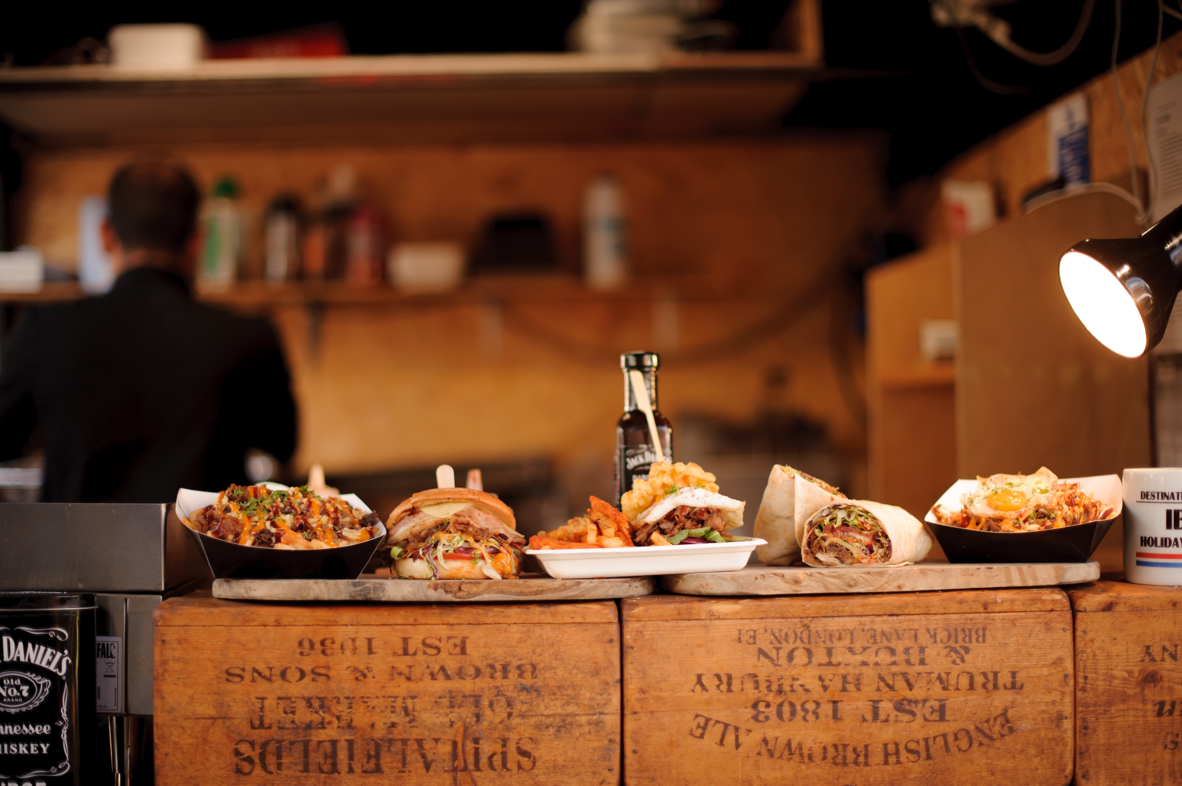
NYC Fast Food Restaurants App
A shiny app provides users with nutrition information for fast food chain restaurants in NYC.

Slide 13

Airline Industry Performance Since COVID-19
Using topics and sentiment tracking to support airlines companies for effective relaunch strategies
Used Packages: nltk, re, json, genism, numpy, scipy, sklearn, pandas, matplotlib, sumy

Slide 14

Airline Industry Performance Since COVID-19
Using topics and sentiment tracking to support airlines companies for effective relaunch strategies

Slide 15

NLP for Google News in a 30-day period
Using topics and sentiment tracking for all Google news in a period of time

Slide 16
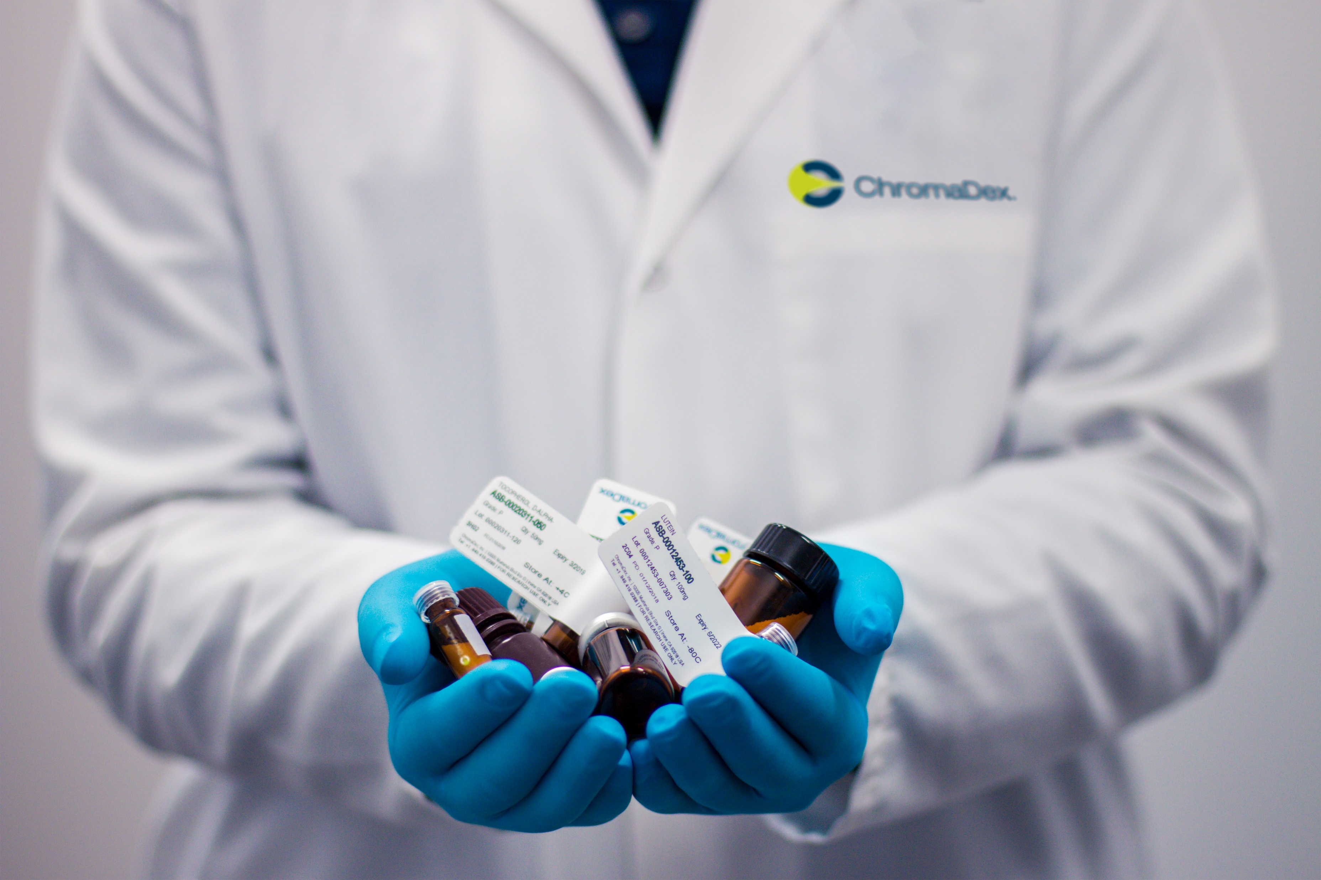
Exploratory Analysis for Hospital Discharges
Exploratory Analysis of the hospital patient discharges using Pandas and Seaborn visualizations.

Slide 17
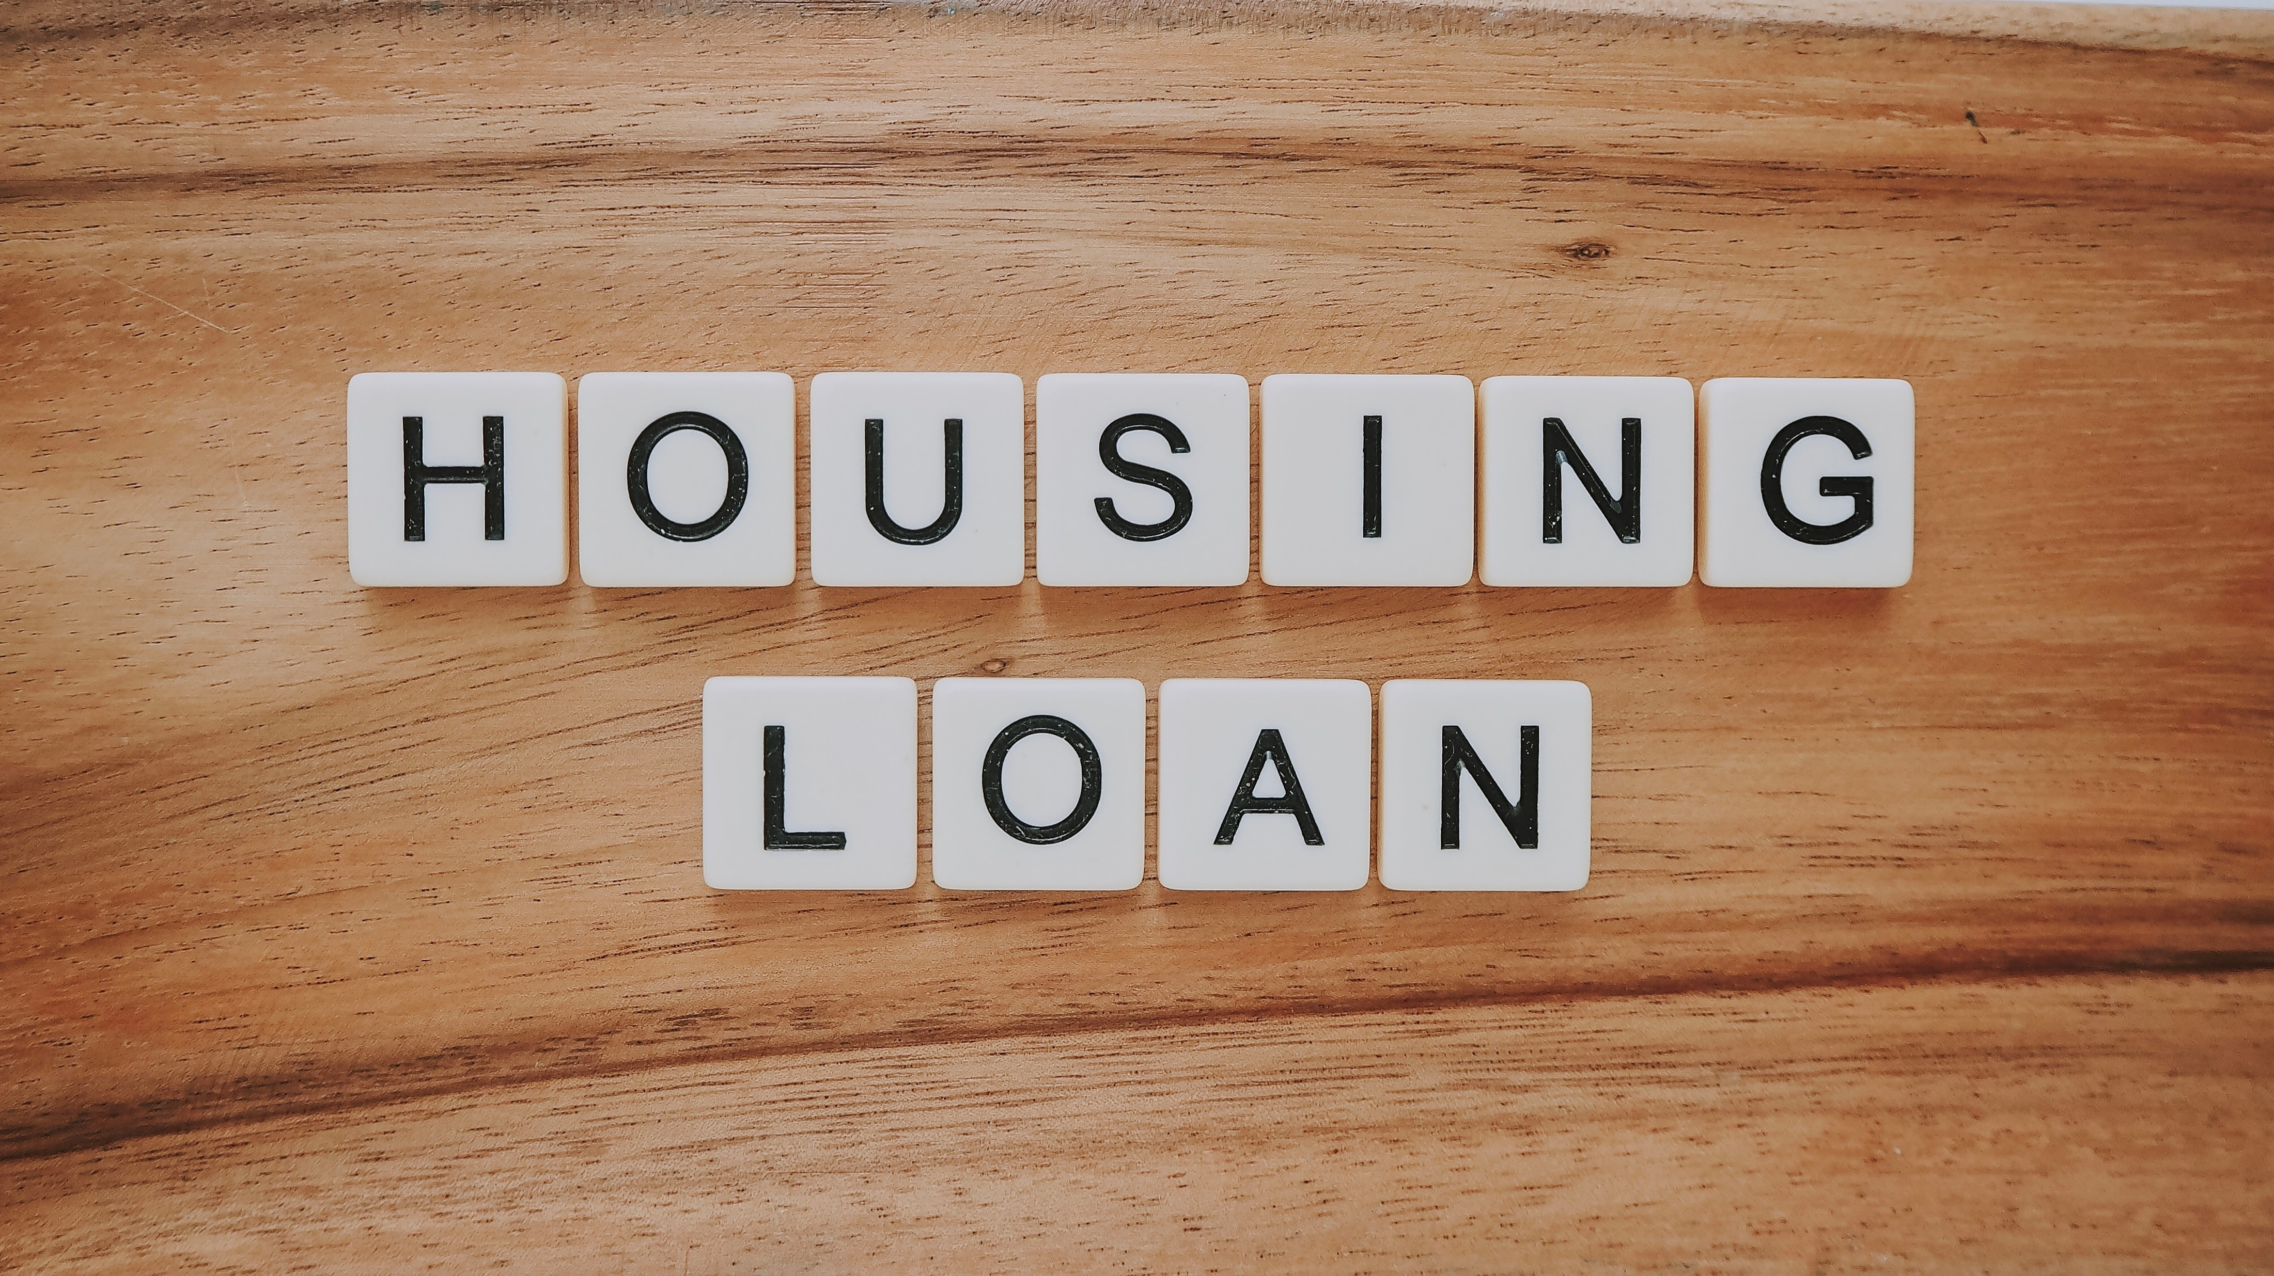
Exploratory Analysis for Mortgage Dataset
Exploratory Analysis and feature engineering creation to support data exploration and prediction models regards to loan fraud.

Slide 18

Pop Vs Metal Lyrics Comparison
This project aims at finding out the insights and differences between Pop and Metal over time.

Slide 19

Stock Analysis Trading Strategies
Analysis of trending stocks including change in price over time, daily returns, and define trading strategies for different stocks.

Slide 20
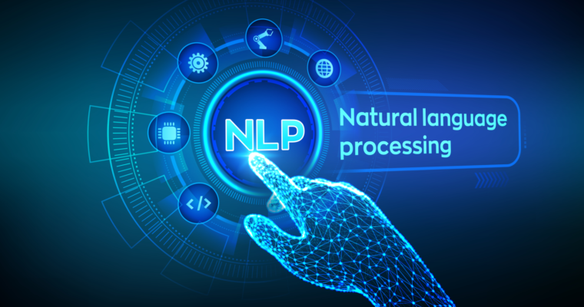
Natural Language Processing Tasks
Some popular techniques used to understand NLP areas, such as Named Entity Recognition (NER), Sematic Similarity, basic text processing, etc.

Slide 21

Credit Cards Datasets: EDA and FE
Create multiple feature engineering to support data exploration and data analysis regarding to credit card fraud detection.

